Slide 1
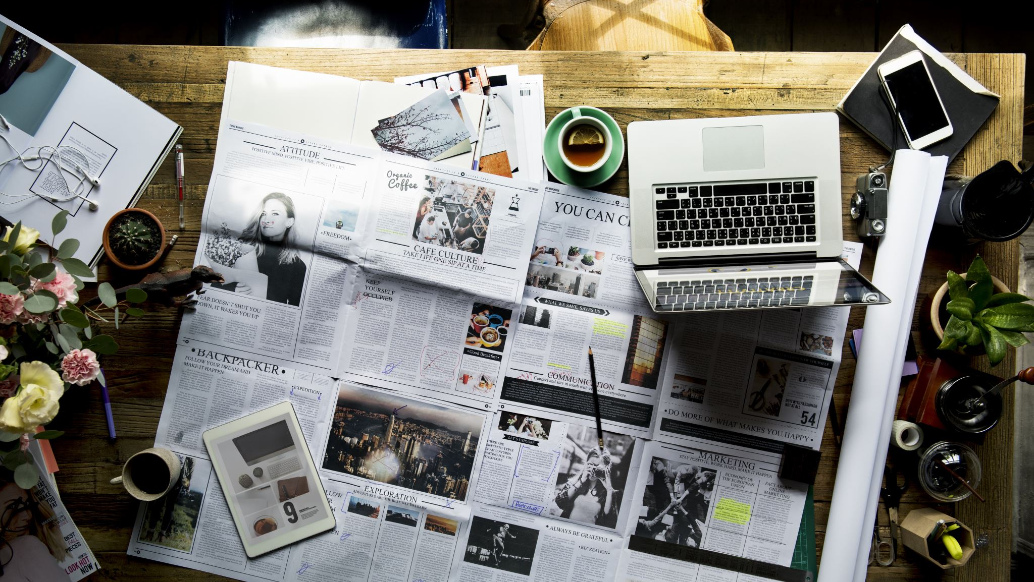
Journalism & disinformation (1): the issues

Slide 2
What is journalism ?
= telling a public what’s happening in the world
= reporting news to a public via media
Cf. ‘Jour’nalism

Slide 3
Substantial elements of journalism
Independency / autonomy
Correctness / accuracy

Slide 4
Information
Corporate,
biased
Public authorities
Private actors (companies, organisations…)
Professional,
autonomous
Journalism / science

Slide 5
Information
Faction
Journalism
Science
Fiction

Slide 6
What is disinformation
?
= the intentional spread of false (fake), uncomplete or biased information, with the aim to manipulate or disrupt

Slide 7
Journalism & disinformation
taken substantially, (real) journalism and disinformation
are opposites,
mutually contradictory

Slide 8
Journalism & disinformation
And now a reality check…
False ‘journalism’
Engaged journalism
(Un)intentionally wrong journalism

Slide 9
False ‘journalism’
As in ‘journalism’ issued by governmental authorities, political parties, midfield organizations or even private companies.
In case we prefer not to use the expression ‘journalism’.
At least we prefer to speak about ‘corporate journalists’.

Slide 10
Engaged journalism
As in opiniating or investigative journalism
= substantially journalism driven by one or another specific idea, conviction or ambition.
Essential here is: the facts remain the beginning ! And there is transparency on the engagement.

Slide 11
Unintenionally wrong journalism
Journalism can be wrong/false or biased unintentionally.
This is no ‘disinformation’, because there is no intention to manipulate.
Nevertheless critics of the news media use the expression often against journalists. Since Trump the reproach of fake news by the traditional media has become common language.

Slide 12
Fraudulent journalism
Exceptionally journalism happens to be wrong/false intentionally…
There is no doubt that this would come down to a major breach of all basic (ethical and legal) rules of journalism and has to be punished likewise.

Slide 13
Some examples
The fake kidnapping of Nadia W. in Disneyland Paris
The invented Flemish Revolution
The invented gunshot
The story of mass destruction weapons in Irak under Saddam Hussein

Slide 14
Factors
The speed of news
The multiplication of communication in society
The digital revolution

Slide 15
The ‘predators’ of journalism
Liberal politics vs. authoritarian government
Freedom of movement vs. violence, threats
A free work environment vs. business/publishers pression/advertising pression
Freedom towards sources of information vs. manipulative sources
Freedom towards the subjects of news vs. threats or repression by news subjects

Slide 16
What’s the problem ?
Is the problem of journalism REAL ? YES
Is the problem of journalism HUGE ? NO *
* As far as journalists and news media responsibles keep to their ethical and legal rules of conduct like independency, accuracy, transparency and some other obligations

Slide 17
What to do ?
What we can’t do: manage the surrounding factors which influence our activity
But we are master of our own rules of conduct and our behavior on the field
→ training session 2

Slide 18
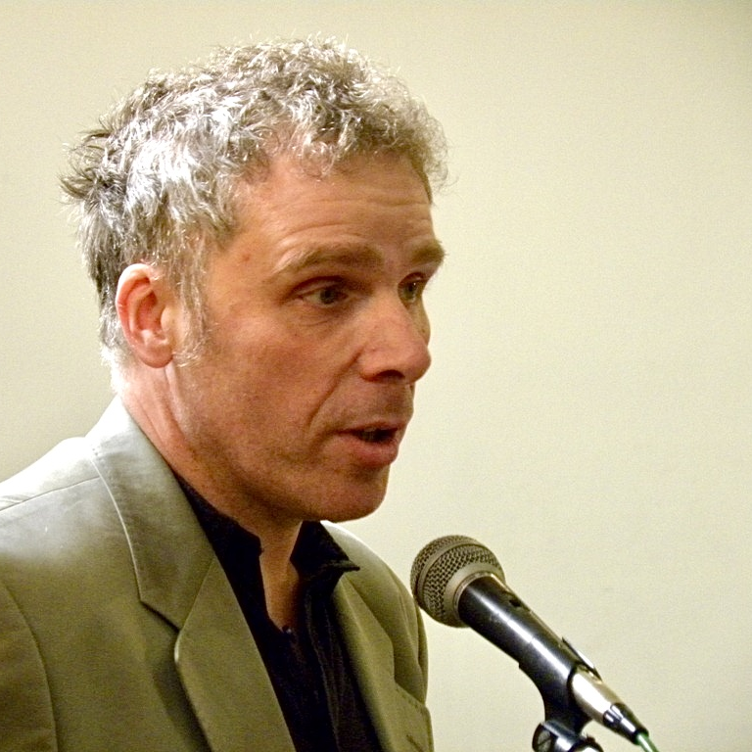
Pol Deltour
Journalist, former secretary general Belgian union of professional journalists, lecturer, legal consultant
https://www.linkedin.com/in/poldeltour/

