Slide 1

Journalism & disinformation (2): the outcomes

Slide 2
Reminder
Journalism = the independent & accurate reporting of news to a public
Challenge
Maximise the basic values of independence and accuracy

Slide 3

Legal context
Ethical rules
E.g. the IFJ Global Charter of Ethics for Journalists

Slide 4
IFJ Code - Intro
The right of everyone to have access to information and ideas, reiterated in Article 19 of the Universal Declaration of Human Rights, underpins the journalist’s mission. The journalist’s responsibility towards the public takes precedence over any other responsibility, in particular towards their employers and the public authorities. Journalism is a profession, which requires time, resources and the means to practice – all of which are essential to its independence.

Slide 5
HOW TO KEEP INDEPENDENCE ?
3 elements of independency:
Safety
Privacy
Intellectual independency

Slide 6
How to keep independence ?
The counterparties
Authorities, government
The own media company (including advertisers)
Sources
Subjects of news
The public

Slide 7
How to keep independence ? IFJ Code
Art. 1 – Respect for the facts and for the right of the public to truth is the first duty of the journalist.
Art. 13 – The journalist shall not use the freedom of the press to serve any other interest and shall refrain from receiving any unfair advantage or personal gain because of the dissemination or non-dissemination of information. He/she will avoid – or put an end to – any situation that could lead him/her to a conflict of interest in the exercise of his/her profession. He/she will avoid any confusion between his activity and that of advertising or propaganda. […]
Art. 14 – The journalist will not undertake any activity or engagement likely to put his/her independence in danger. He/she will, however, respect the methods of collection/dissemination of information that he/she has freely accepted, such as ‘off the record’, anonymity, or embargo, provided that these commitments are clear and unquestionable.

Slide 8
Beware of the notions
Independency
Objectivity
Neutrality
Diversity

Slide 9
The eternally imperfect independence …
‘Transparency is the new objectivity’

Slide 10
HOW TO STAY ACCURATE ?
Check check check
Hear hear
Complete and correct
Distinguish opinion from facts

Slide 11
Accuracy: Check check check
Art. 1 – Respect for the facts […] is the first duty of the journalist.
Art. 3 – The journalist shall report only in accordance with facts of which he/she knows the origin. The journalist shall not suppress essential information or falsify any document. He/she will be careful to reproduce faithfully statements and other material that non-public persons publish in social media.
Art. 5 – The notion of urgency or immediacy in the dissemination of information shall not take precedence over the verification of facts, sources and/or the offer of a reply.

Slide 12
Some factchecking initiatives
https://www.publicmediaalliance.org/tools/fact-checking-investigative-journalism/
https://newsinitiative.withgoogle.com/fr-fr/resources/trainings/verification/google-fact-check-tools/
https://belux.edmo.eu/
https://crisiscenter.be/en/risks-belgium/security-risks/disinformation/fact-checking

Slide 13
The problem with factchecking …
Too little to late ☹
So act quickly !
E.g. the factchecking by NBC News of the false allegation by Trump of immigrants eating dogs and cats in Springfield

Slide 14
Accuracy: Hear hear
Art. 10 – The journalist will consider serious professional misconduct to be […]
distortion of facts
slander, libel, defamation, unfounded accusations

Slide 15
Accuracy: Complete and correct
Art. 6 – The journalist shall do the utmost to rectify any errors or published information which is found to be inaccurate in a timely, explicit, complete and transparent manner.

Slide 16
Accuracy: distinguish facts from opinion
Art. 2 – [The journalist] will make sure to clearly distinguish factual information from commentary and criticism.

Slide 17
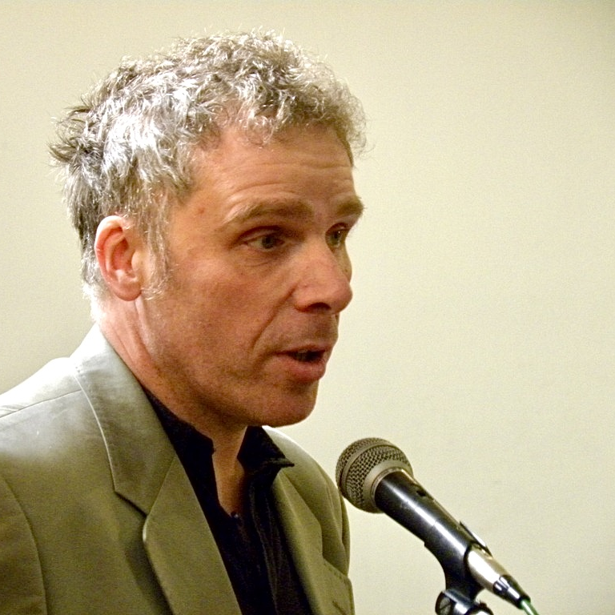
Pol Deltour
Journalist, former secretary general Belgian union of professional journalists, lecturer, legal consultant
https://www.linkedin.com/in/poldeltour/

