Slide 1


The DIGITalization of the ELDerly

Slide 2
FPPJ
It is a foundation representing the journalistic profession in Belgium and will implement a course focusing mainly on strategies to cope with the problem of fake news, transferring the appropriate tools and analytical skills.
The partners
The University
of Macerata
It is an institution dedicated to education and research. It will focus more on developing a transversal training pathway, embracing different subject areas (IT, law, sociology, communication and mass media studies, psychology, ethics).

Slide 3
Erasmus+
Small-scale partnerships in adult education - KA210-ADU
12 months
60.000 €
General Objective
Creating upskilling pathways, improving accessibility and increasing take-up of adult education
Notes:
DIGITELD is a project funded by the Erasmus+ programme, in line with the European Commission's priority on improving accessibility and increasing take-up of adult education.

Slide 4
Specific Objectives
  Improve the knowledge and skills of seniors in combating the phenomenon of fake news - Digital Media & Information Literacy (MIL)
  Developing Online Training Modules on MOOC Platform
  Developing Best practices, Guidelines and Policy Recommendations as dissemination tools
  Fostering research in the academic field
Notes:
Indeed, the project aims to address the need to improve the Digital Media & Information Literacy skills of adults over 65, in order to fight the phenomenon of fake news.
Media literacy is essential for everyone, influencing our perception of the world and our civic engagement through various media. The prevalence of fake news highlights the need for media and digital literacy to ensure accurate representations in society. Older adults, aged 65 and above, often have lower digital literacy, making them more susceptible to believing and sharing fake news. Thus, it's important to invest in training and information for this age group to enhance their ability to evaluate online information and discern the reliability of sources.
Based on this premise, the project is based on 4 specific objectives:
Improve the knowledge and skills of seniors in combating the phenomenon of fake news
Developing Online Training Modules on MOOC Platform
Developing Best practices, Guidelines and Policy Recommendations as dissemination tools
Fostering research in the academic field
As I said, the phenomenon of digital disinformation and fake news gains more prominence among those with low digital skills, and it is particularly evident among older people over 65. The objective is to bridge this skills gap, through the organization of two trainings aimed at over 65 individuals in Belgium and Italy.

Slide 5
The courses
led by professionals working in journalism
and academic fields
The skills
focus on developing technical and analytical skills that can help older people who use digital tools, to recognize fake news, especially in the area of political propaganda and health disinformation.
Notes:
2) The second objective is the development of online training (MOOC), elaborated by the University of Macerata and supported by the Foundation.
The training will focus on enhancing the technical and analytical skills of older adults, which are crucial for recognising fake news, especially in political propaganda and health disinformation.
The expected outcome is the elaboration of a MOOC, which will be available for everybody on the EPALE platform, the Erasmus+ platform dedicated to the adult learning.
A key aspect of the training will be transnational cooperation between the two partners, through an exchange not only of knowledge and methodologies but also of skills and perspectives that will enhance the project's potential.

Slide 6
Best Practices and Policy Recommendations
The goal is to create Best Practices to help senior Internet users combat digital disinformation, particularly in the realms of political propaganda and health.
Notes:
3) The third objective is represented by good practices and policy recommendations.

Slide 7
Best Practices and Policy Recommendations
The expected outcome is the creation of a single document outlining these best practices for seniors and policy recommendations to address the issue of fake news.
This project will benefit from the expertise of its partners and close collaboration with local civil society organizations involved in citizen engagement.
Ultimately, the project aims to produce a document with policy recommendations, which will be submitted to the European Parliament, as well as the national parliaments of Italy and Belgium.
Notes:
The expected outcome is the creation of a single document outlining these best practices for seniors and policy recommendations to address the issue of fake news and to help senior Internet users combat digital disinformation.

Slide 8
Academic research
The expected outcome is the collection of qualitative and quantitative data for the future development of a research paper.
The proposed training intervention and the evaluation of its effectiveness will enable the collection of data by administering surveys to older adults, before and after their participation in the training.
Academic research focusing on MIL & DL has found that while there is a gap in research on its value and teaching methods for various age groups There is a noticeable shortage of research addressing how older individuals use, understand, and critically engage with media.
Notes:
4) The last specific objective is related to the academic research. The training will involve surveys for older adults to assess its effectiveness, addressing a gap in understanding media use and engagement. This intervention aims to collect qualitative and quantitative data for future research on media and digital literacy.

Slide 9
In Italy
In Belgium
the 65-74 age group has the highest percentage of low digital skills (54%), showing that the Italian country is still lagging far behind other EU member states.
we find a more differentiated situation for the 65-74 age group: while 9% of respondents have advanced skills and 20% have basic skills, 18% have low skills, and 17% have very low.
based on research conducted by Istat in 2019
based on a 2021 Statbel survey on digital skills
Notes:
The desk research activities resulted in three country reports, in order to analyse in more detail the situation in the two countries where the trainings will be implemented. In addition, a report on a third EU country, which can be regarded as virtuous in this respect, was drawn up: the Netherlands.

Slide 10
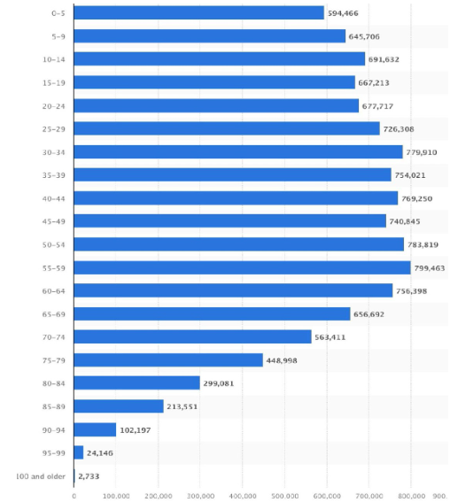
Country reports
Belgium
POPULATION OF BELGIUM IN 2023, BY AGE GROUP (STATISTA, 2023)
Notes:
Belgium, with its three main regions—Flanders, Wallonia, and Brussels-Capital—faces a significant demographic shift as its population ages. As of 2019, the average age was 41.7 years, with life expectancy higher in the Flemish Region compared to Wallonia and Brussels. By 2023, there were about 2,700 centenarians in Belgium, reflecting both remarkable longevity and an urgent need for robust support systems for Belgian seniors.
As evidenced by recent data, Belgian elderly population is substantial and projected to grow even further in the coming years. Therefore, it is crucial that we equip our seniors with the right tools and infrastructure to navigate social media and digital devices effectively.
By fostering digital literacy among older adults, we can empower them to understand and fact-check information, particularly in an era full of fake news. This knowledge will enable them to discern trustworthy sources and approach topics with confidence, going beyond reliance on traditional broadcasting systems alone.

Slide 11
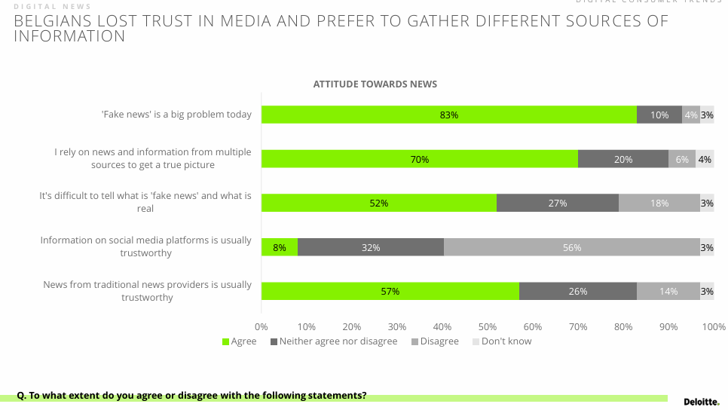
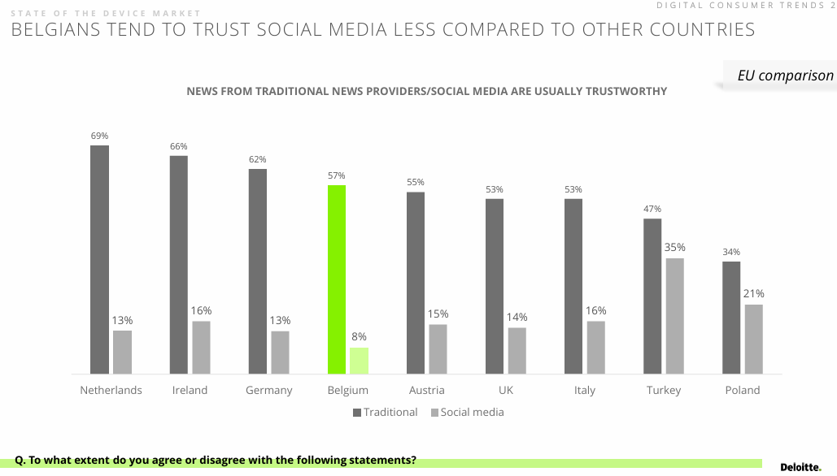
Country reports
Belgium
Recognition of Fake News Issue:
83% of respondents recognize that Fake News is a fairly relevant issue nowadays.
Verification Practices:
Only 70% of respondents search on multiple sites to verify the veracity of a news item.
Difficulty in Recognizing Fake News:
Little more than half of the interviewees find it difficult to recognize false news from true ones.
Only 18% consider recognizing a fake news as easy.
Trust in Information Sources:
56% of respondents believe social media platforms are untrustworthy information providers.
Almost the same percentage believe traditional news providers to be trustworthy.
Cross-Country Comparison:
Fig. 2 shows that Belgians tend to trust social media less than respondents from other count
Notes:
However, the digitalization of everyday life presents challenges, especially for older adults unfamiliar with computers, smartphones, and the internet. Statistics reveal that 58% of Belgians aged 55 to 74 lack basic digital skills, and 15% have never used the internet. This digital divide underscores the need for targeted interventions to bridge these gaps and ensure our seniors are not left behind.
By addressing these challenges head-on, we can help our elderly population stay connected, informed, and integrated into the digital age, enhancing their quality of life and fostering a more inclusive society for all.
As showed in the Fig.1 about the attitude towards news, almost all of the respondents (83%) recognize that Fake News is a fairly relevant issue nowadays while only 70% search on multiple sites to verify the authenticity of a news. For little more than half of the interviewees it is difficult to recognize the false news from the true ones and only the 18% considers that recognize a fake new is easy. Also, 56% of the respondents believe social media platforms being an untrustworthy information’s’ provider and almost the same percentage believe traditional new provider to be trustworthy.
For a cross-country comparison related to the use of traditional sources or social media to find news, Fig.2 shows that Belgians tend to trust social media less than other countries.
That said, there needs to be a shift in how elderly Belgians engage with social media and new technologies. By developing digital skills, they can begin to see new technologies and social media as tools that support their daily lives, helping them avoid isolation and stay current with the times.

Slide 12

Country reports
Belgium
From Data to Action
At Project Level:
A HEALTHY DIGITAL EUROPE (AHDE)
Project e-EngAGEd
At Policy Level:
Brussels-Capital
Flanders
Wallonia
Notes:
There are several initiatives and projects in which Belgium participates, with the aim of supporting the community in combating misinformation, media literacy and skill acquisition. At project level:
A HEALTHY DIGITAL EUROPE (AHDE): With this project the three different partners want to encourage learning for adults and improve the accessibility of adult education. More specific: green and digital skills, quality education for seniors, healthy and digital lifestyle. The project has the objective to help adults to take an active part in our digital society
Project e-EngAGEd: (Intergenerational Digital Engagement), funded by the European Commission (Programme CERV),is toimprove critical thinking and media literacy by training young volunteers to act as facilitators that can transmit their knowledge to older adults.
At policy level, all three federated regions have implemented digitization plans/programs as central components of their policies, recognizing the specific needs of the elderly to ensure equitable access to online public services:
1) The Brussels Region's "Plan d'appropriation numérique" for 2021-2024 aims to reduce disparities in digital access, use, and knowledge by identifying six priority groups to be supported: job seekers, youth, older adults, people with disabilities, disadvantaged populations, and women. Action 14 of this plan aims to provide older adults with safe training in new technologies, with initiatives extending to both nursing and retirement homes. Nursing homes receive support for organizing and funding programs to improve basic digital skills, prioritizing training in communication, banking, online public services, and cybersecurity.
2) In Flanders, equal opportunity policy focuses on local e-inclusion through the "Iedereen Digitaal" (All Digital) action plan. The March 2022 Flemish Plan for Aging includes five actions to promote digitization among older people, including educational policies to combat digital exclusion, networking of "digibuddies," monitoring of digital skills of civil servants, investment in communication technologies, and a focus on vulnerable older populations.
3) The "Walloon Digital Strategy" allocates funds to improve the region's digital skills, including projects aimed at digital inclusion through increased public digital spaces and female workforce participation in the IT sector. Digital literacy and skills are emphasized under the federal poverty reduction policy, with the establishment of an "experts by experience" service to promote the use of e-ID for simplified access to rights and services. Specific funding opportunities, events and organizational support are provided under this program.
As we approach the European elections, it is a call to action for all stakeholders involved—governments, NGOs, tech companies, and communities—to prioritize media literacy for the elderly. By empowering them with the knowledge and tools to navigate the digital world safely, we ensure that their voices are heard and that they remain an active and informed part of the electorate. It's not just about preparing for an election; it's about upholding the values of an inclusive and informed democratic society.

Slide 13

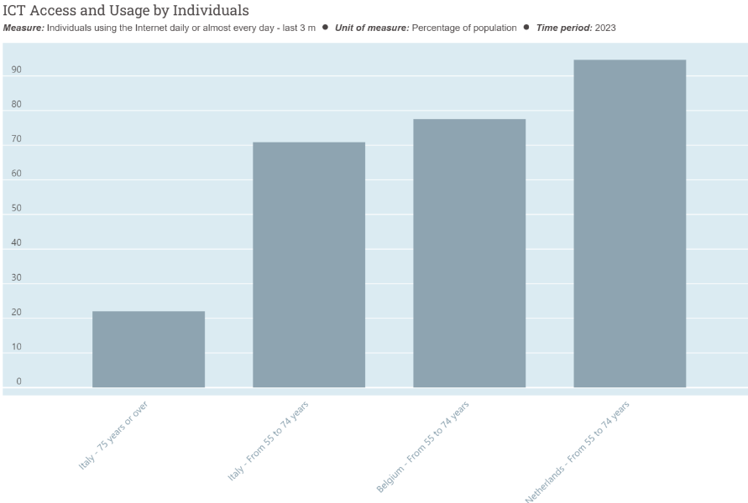
Country reports
24.1% (almost a quarter) of the total
population are over-65
Concerning digital competencies,
Italy ranks near the bottom in the
European standings (ISTAT 2023b;
European Commission, 2022)
Italy
In the age group 65-74 years, regular Internet users are 57.7%, i.e. 11% less than the EU27 average (Istat, 2024)
Individuals over 75 using the Internet daily or almost every day are 22% (OECD, 2024)

Slide 14

Country reports
Italy
76.5% of Italians believe that it is more and more difficult to identify fake
news, 20.2% feel they lack the necessary skills, and 61.1% believe they only
partially possess skills to recognise it (Ital Communications-Censis 2023).
81.5% of individuals aged 65 and older are the most likely to agree that fake
news is becoming more sophisticated and difficult to detect (Ital
Communications-Censis 2023)
The analysis of the projects implemented to enhance the digital skills of
Italian seniors has highlighted some limitations: i) projects lack a clear
reference to a theoretical framework; ii) do not conduct an ex-ante and
ex-post evaluation of the skills actually acquired by the participants; iii) adopt
different teaching approaches; iv) focus mainly on basic literacy in using
devices and less on digital media literacy or countering online disinformation

Slide 15
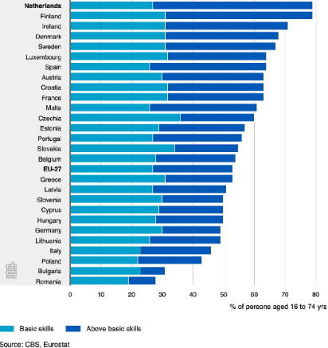
Country reports
Netherlands

Slide 16
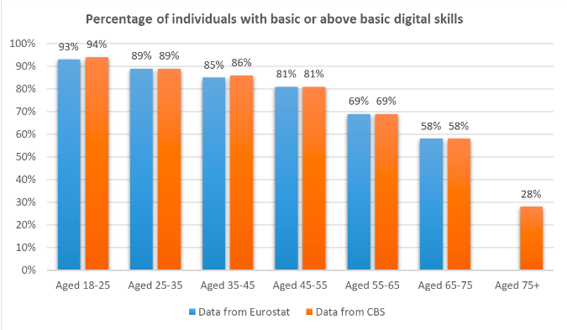
Country reports
Netherlands
While Netherlands has a high percentage of population declaring to have at least basic digital skills, the percentage goes diminishing as the age grows.
With an average of more than 90% of the population having access to the internet at home, the infrastructure seems well functioning and trusted.
The high levels of trust in Dutch news media, coupled
with minimal concern about ‘fake news’, underscores
the importance of fostering a robust media
landscape that prioritizes quality journalism and
fact-checking initiatives.

Slide 17
Thank you all
for your support and attention

